Slide 1
Query by Humming Searching Oct 14th
Jiarui Xu(Jerry), Alexander Lerch

Slide 2
This week
Evaluate note detection
Implement DTW
Implement Edit Distance
Build up primary Query by humming system
Apply DTW and Edit Distance to QBH system to see the effect
Thinking of modification

Slide 3
Evaluate note detection
The error calculation is not based on pitch but based on the number of points that is not zero in error array.
The reason that not to calculate the pitch difference is that: woman sings higher than man, we cannot punish a woman harder than a man.
The result(after processing 50 wave files and corresponding 50 midi files):
Average error points for each wave file: 171.7
Hop size: 1024
Duration for each file: 40seconds
Sample rate: 44100 Hz
Total points for each file: 1723
Accuracy: 171.7/1723=9.965%

Slide 4
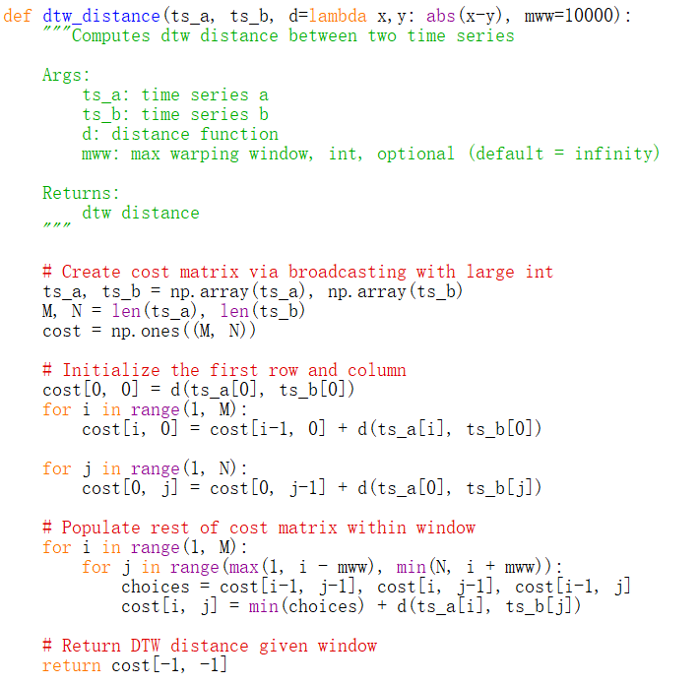
Implement DTW
No computational accuracy yet, because it is slow overall, taking 20 minutes to retrieve a 10-file process.

Slide 5
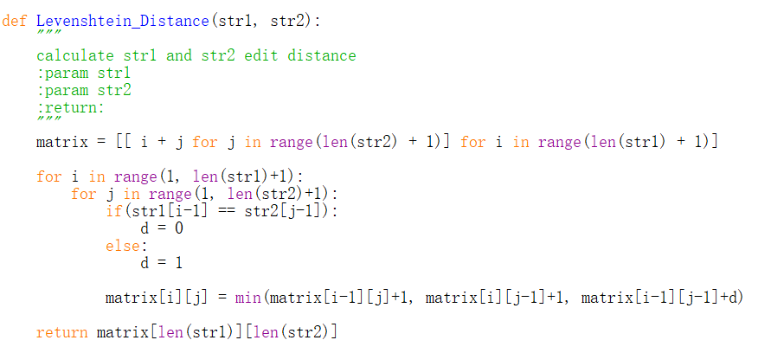
Implement Edit Distance
No computational accuracy yet, because it is slow overall, taking 10 minutes to retrieve a 10-file process.

Slide 6
Problems in implement
1.too slow
Reason:
1.use relative pitch group not up same down group
the reason not to use up same down group is that it depends too much on the accuracy of onset, but I’m not so confident with my onset detection.
2.hop in every file in many times, because The hum doesn't have to start at the beginning, so I need to walk through all the MIDI fragments of similar length in each MIDI file to get the MIDI fragment that best matches the hum.
3. Call pretty_MIDI repeatedly to extract note information from MIDI.
2.Accuracy:
Edit distance have more accuracy(feel like) and discrimination than DTW.

Slide 7
Modifying
For fast searching:
1. make a data store that contains fragments. For each MIDI, there are several lengths of fragment (e.g., 10 second fragment, 15 second fragment, 20 second fragment... Each length segment traverses the entire MIDI), so instead of calling pretty_MIDI every time to extract information from the MIDI file, I can directly call the data of this segment length in the Data store to calculate the distance according to the most suitable segment length matching the hum length.
2.Modifying the onset detection, so that I can then use up-same-down method to compare melody instead of using relative notes’ method.
For accuracy, currently there are no statistics on the accuracy of multiple waves due to slow running, this part will be done after improving searching speed.

Slide 8
Modifying
For data store: compress the data for each song(primary thinking)
VGGish: based on TensorFlow, VGGish. VGGish supports extracting semantic 128-dimensional embedding feature vectors from audio waveforms.
Compress pitch into one Octave(3:up same down)
Classify the note’s duration into like: quarter note, half note etc.(but this also requires detecting tempo of vocal)

Slide 9
Thank you!

